Slide 1
HYPOTHESIS TESTING
MPA 630: Data Science for Public Management
November 15, 2018
Fill out your reading report on Learning Suite

Slide 2
PLAN FOR TODAY
Randomness, repetition, and replicability
Why are we even doing this? (again!)
Burdens of proof
How to test any hypothesis

Slide 3
RANDOMNESS, REPETITION, & REPLICABILITY

Slide 4
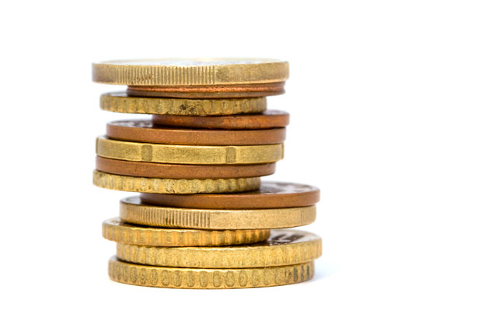

Slide 5
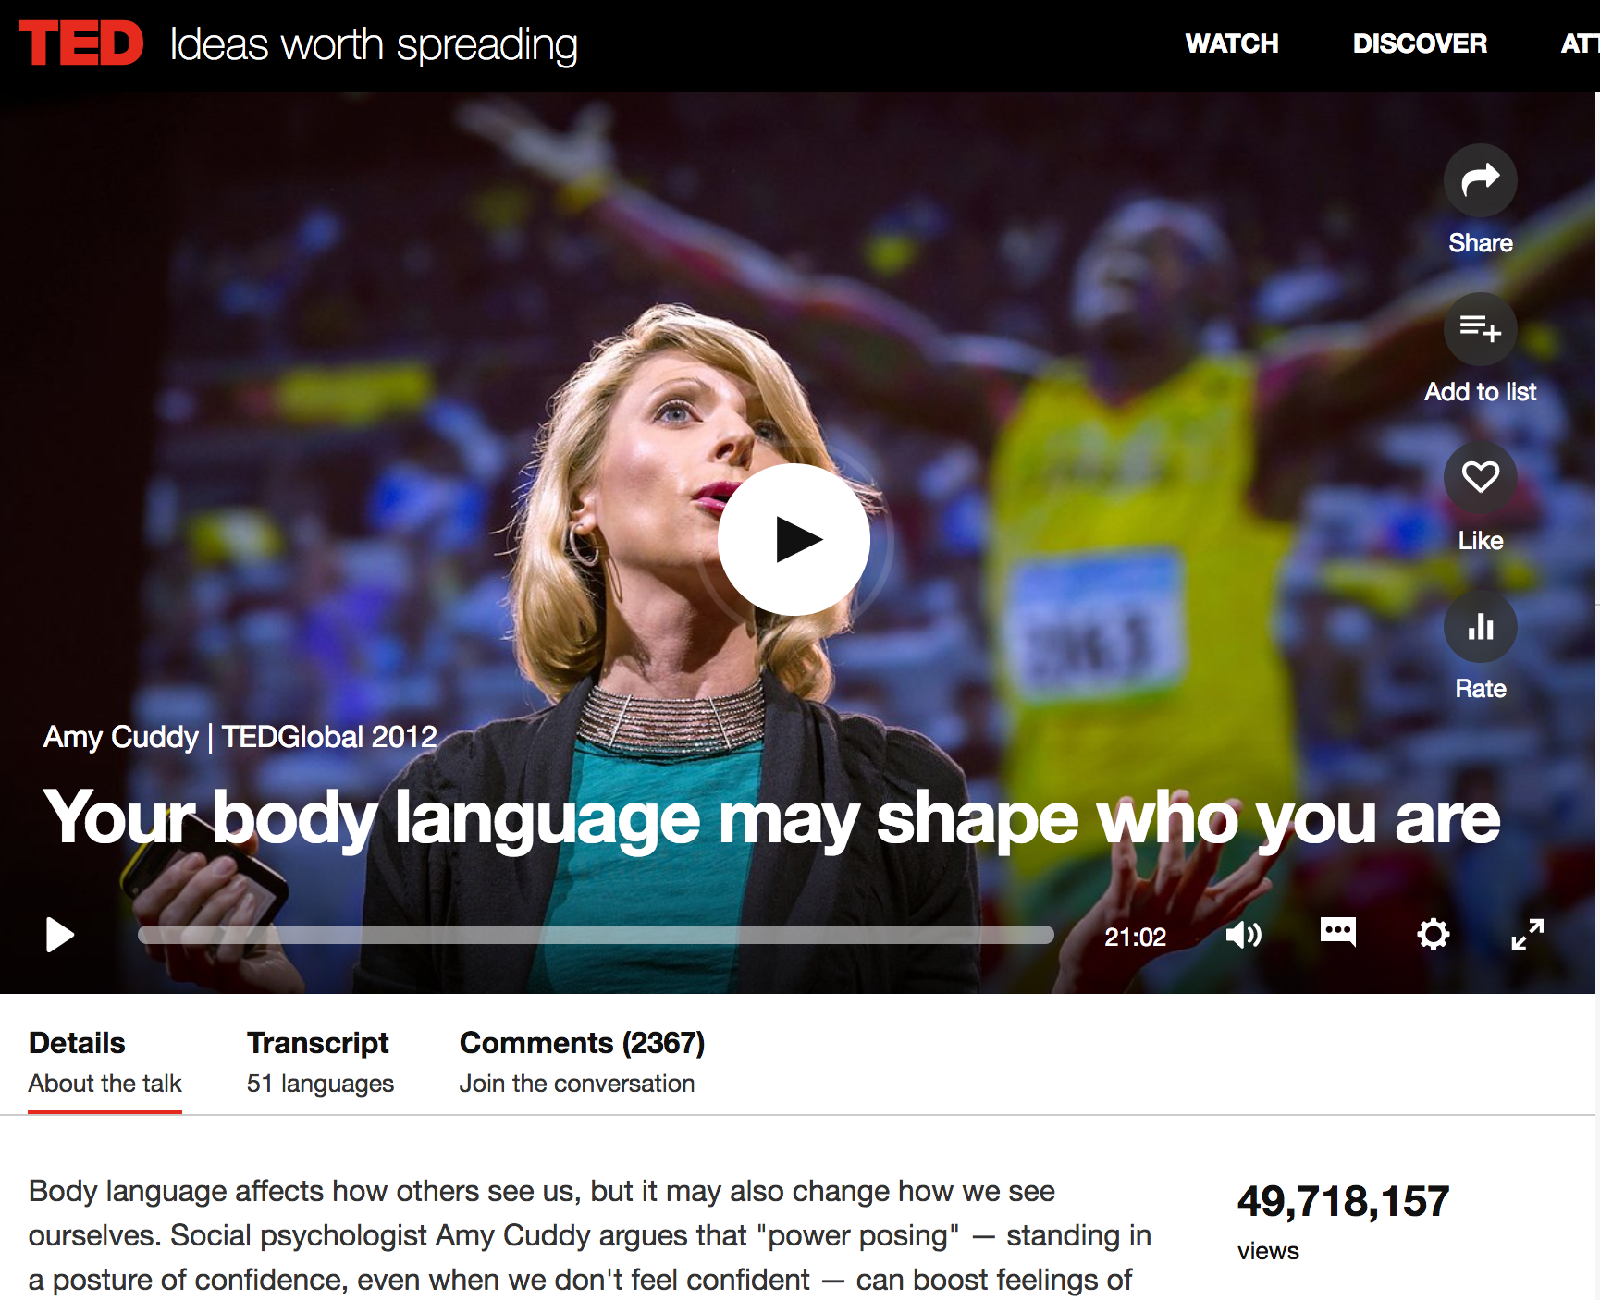

Slide 6
POWER POSING
Increases individual perception of power
Increases testosterone and decreases cortisol
She made a guess at a population parameter and published it
This is the process of science!

Slide 7
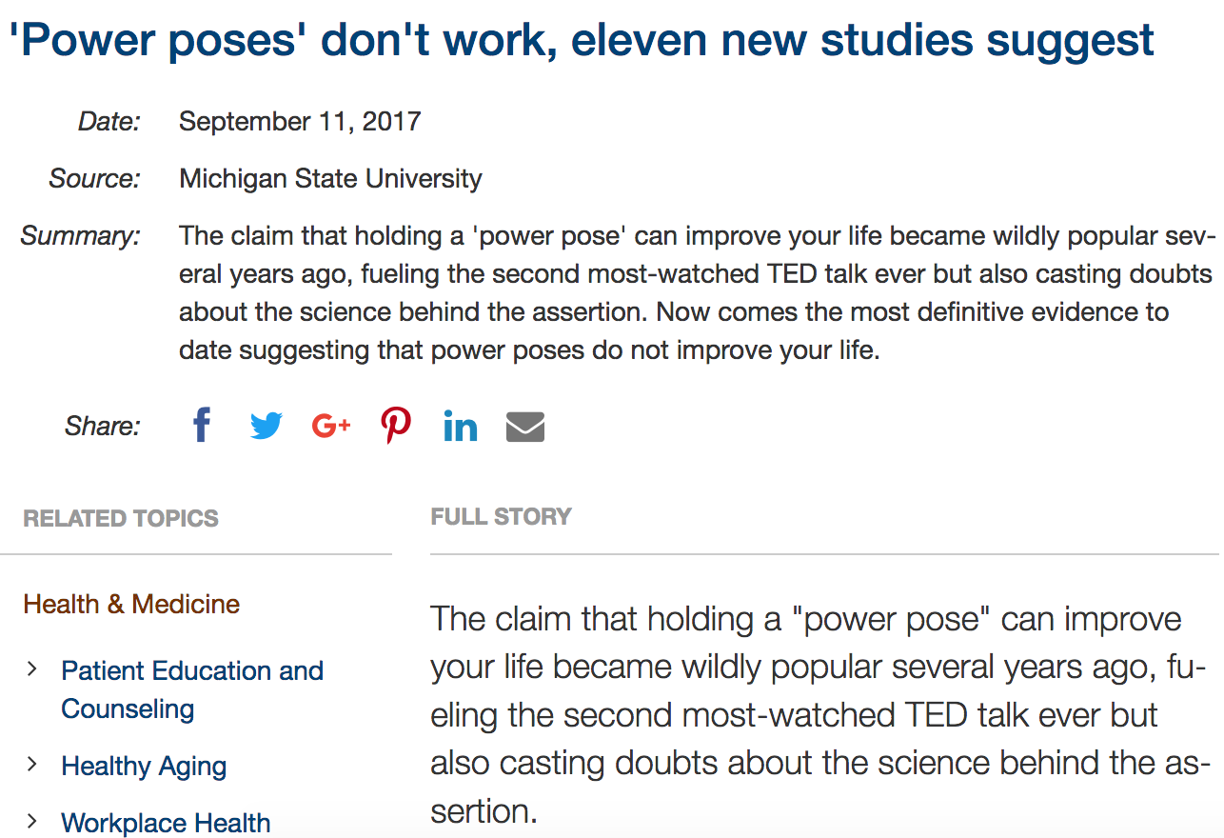
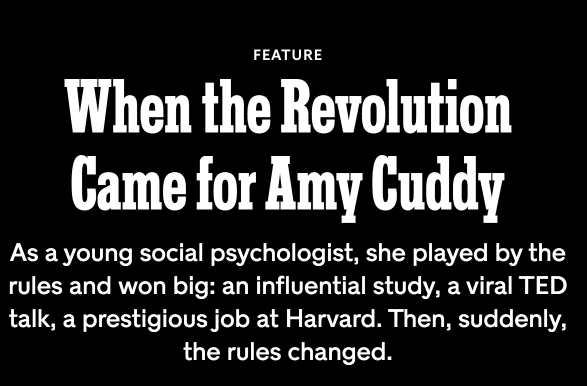
RUH ROH
Notes:
https://www.sciencedaily.com/releases/2017/09/170911095932.htm

Slide 8
BUT WAIT
Increases individual perception of power
Increases testosterone and decreases cortisol

Slide 9
MORAL OF THE STORY
Randomness is weird
Capturing true population parameters is hard
Replication and repetition are needed to check the net

Slide 10
WHY ARE WE EVEN DOING THIS?
Round 2!

Slide 11
POPULATION PARAMETERS
Key assumption in the flavor of statistics we’re doing:
There are true, fixed population parameters out in the world

Slide 12
POPULATION VS. SAMPLE
Proportion
$$p$$
$$\hat{p}$$
$$δ$$
Mean
$$μ$$
$$\overline{x}$$
Difference between proportions
$$p_{1} −p_{2}$$
$${\hat{p}}_{1} −{\hat{p}}_{2}$$
Difference between means
$$μ_{1} −μ_{2}$$
$${\overline{x}}_{1} −{\overline{x}}_{2}$$
Intercept
$$β_{0}$$
$${\hat{β}}_{0}$$

Slide 13
WHY WE SIMULATE
Is it accurate?
Is it real?
Is it substantive?
Is $\overline{x}$ an accurate guess of $μ$?
Is ${\overline{x}}_{2} − {\overline{x}}_{1}$ or ${\hat{p}}_{2} − {\hat{p}}_{1}$ real? Does it matter?
Width of confidence interval
Important numbers included in confidence interval

Slide 14
BURDENS OF PROOF

Slide 15
AMERICAN LEGAL SYSTEM
Accused must be judged
Presumption of innocence
Accuser has burden of proving guilt
Judge/jury decide guilt based on amount of evidence
We never prove innocence; we try (and fail) to reject innocence

Slide 16
LEGAL EVIDENTIARY STANDARDS
Preponderance of evidence
Clear and convincing evidence
Beyond reasonable doubt
Why do we have these different levels?
We’re afraid of locking up an innocent person

Slide 17
Actual truth
Guilty
Not guilty
Yay!
_{True positive}
Oh no!
_{False positive (I)}
Guilty
Jury decision
Oh no!
_{False negative (II)}
Yay!
_{True negative}
Not guilty

Slide 19
STATISTICAL “LEGAL” SYSTEM
Sample statistic (δ) must be judged
Presumption of no effect (null)
You have burden of proving effect
You decide “guiltiness” of effect based on amount of evidence
We never prove that the null is true; we try (and fail) to reject the null

Slide 20
Actual truth
Yes effect
No effect
Yay!
_{True positive}
Oh no!
_{False positive (I)}
$$α$$
Yes effect
0.10
0.05
Result of hypothesis test
0.01
Oh no!
_{False negative (II)}
Yay!
_{True negative}
No effect

Slide 21
STATISTICAL SIGNIFICANCE
There’s enough evidence to safely reject the null hypothesis

Slide 22
P-VALUES
The probability of observing an effect at least that large when no effect exists

Slide 23
NOBODY UNDERSTANDS THESE
http://fivethirtyeight.com/pvalue

Slide 24
HOW TO TEST ANY HYPOTHESIS

Slide 25
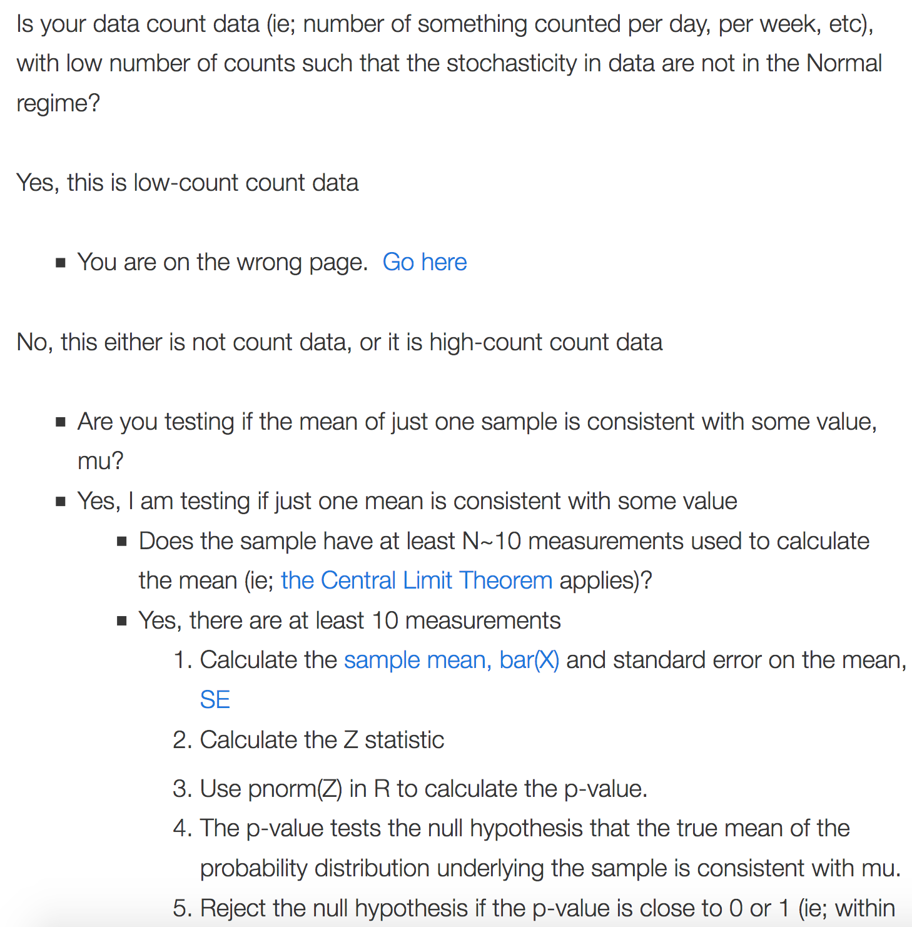
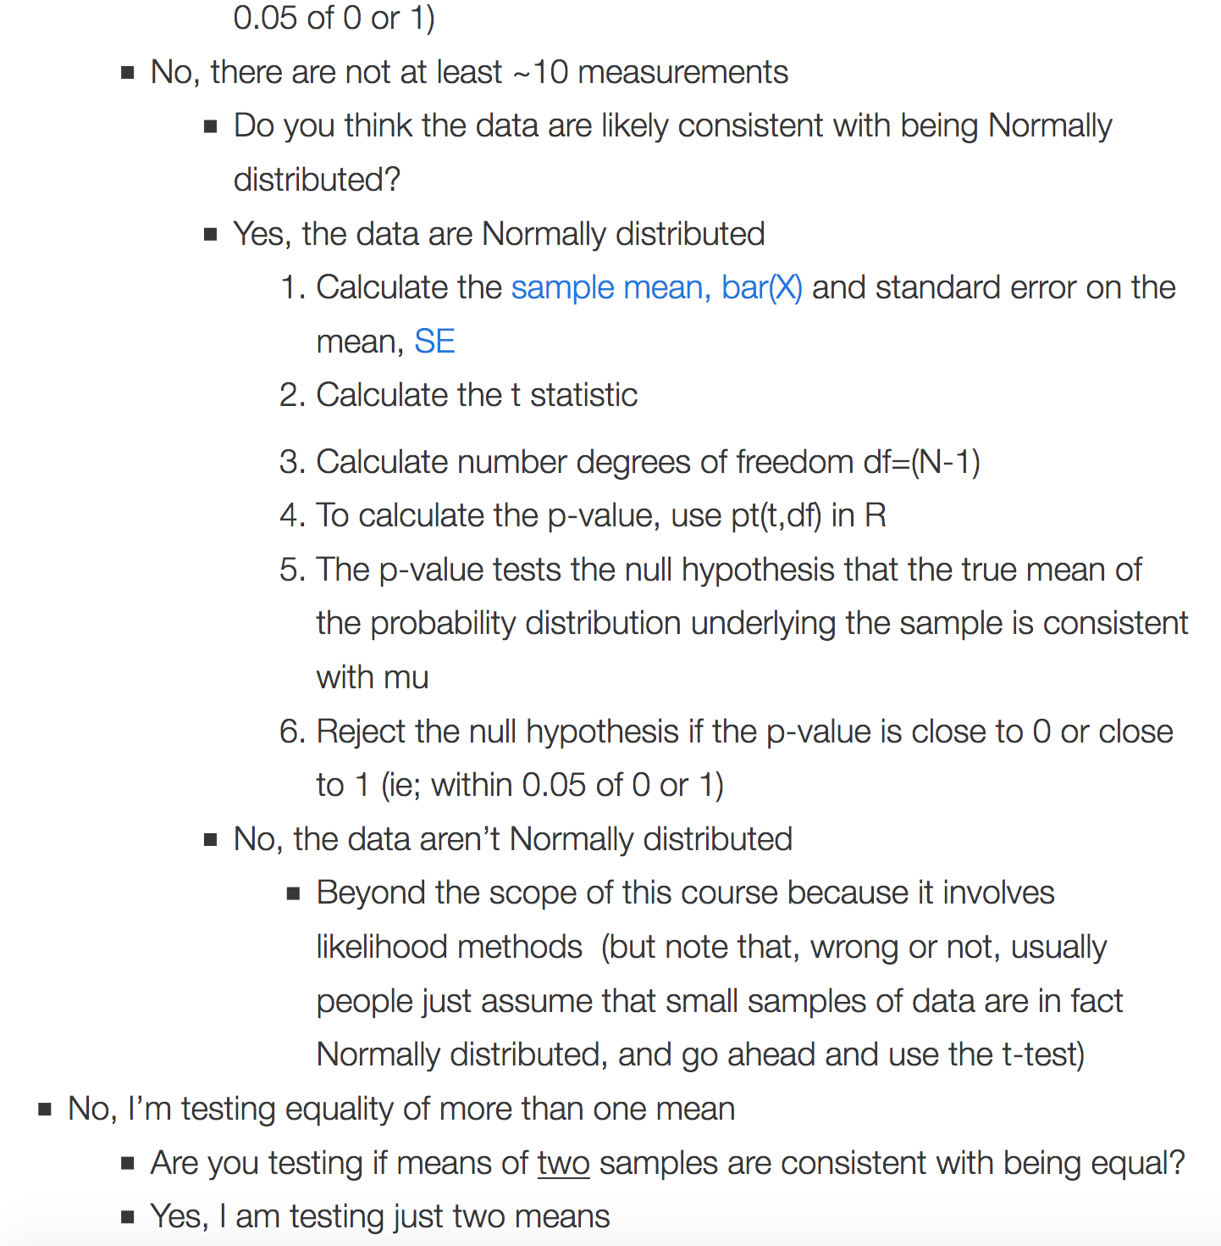
Notes:
http://sherrytowers.com/2013/09/23/hypothesis-testing-of-sample-means-flowchart/

Slide 26
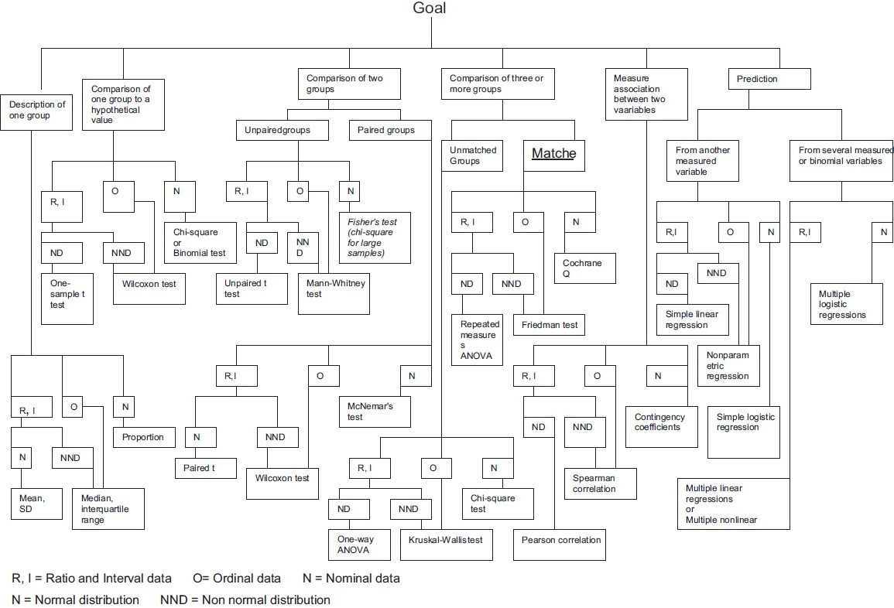
Notes:
http://www.pnrjournal.com/article.asp?issn=0976-9234;year=2010;volume=1;issue=2;spage=61;epage=63;aulast=Jaykaran

Slide 27
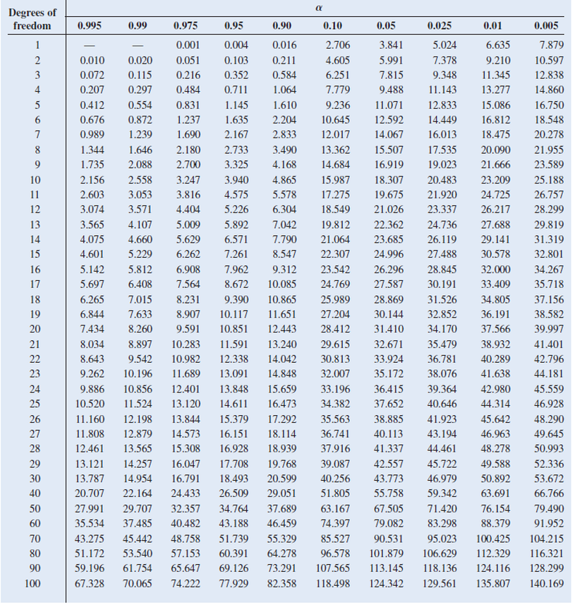

Slide 28
SIMULATIONS AND HYPOTHESES

Slide 29
Find δ The sample statistic: diff in means, mean, diff in props, etc.
Invent world where δ is null Simulate what the world would look like if there was no effect.
Look at δ in the null world Is it big and extraordinary, or is it a normal thing?
Calculate probability that δ could exist in the null world This is your p-value!
Decide!

